Slide 1

Accessibility, from
Design to Development
Building accessibility into your SDLC
March 12th, 2026

Slide 2


Your presenters
Wesley Hulsizer
Ian O’Bara
Team Lead, Delivery Services
Senior Accessibility Consultant

Slide 3
Agenda
Introduction: Where accessibility breaks down
Playbook outline: What is an Accessibility Playbook?
Stage gates: You checkpoints for accessibility success
Ceremonies: Plays you can use to pass each stage gate
Tools: The equipment that supports your ceremonies
and outcomes

Slide 4
Problem statement
When accessibility issues surface late in the development cycle or after an asset is live, it takes longer and costs more to fix them. And the more problems you find, the harder it is to ensure your process for handling them is thorough and efficient enough to minimize your exposure and
production issues.

Slide 5

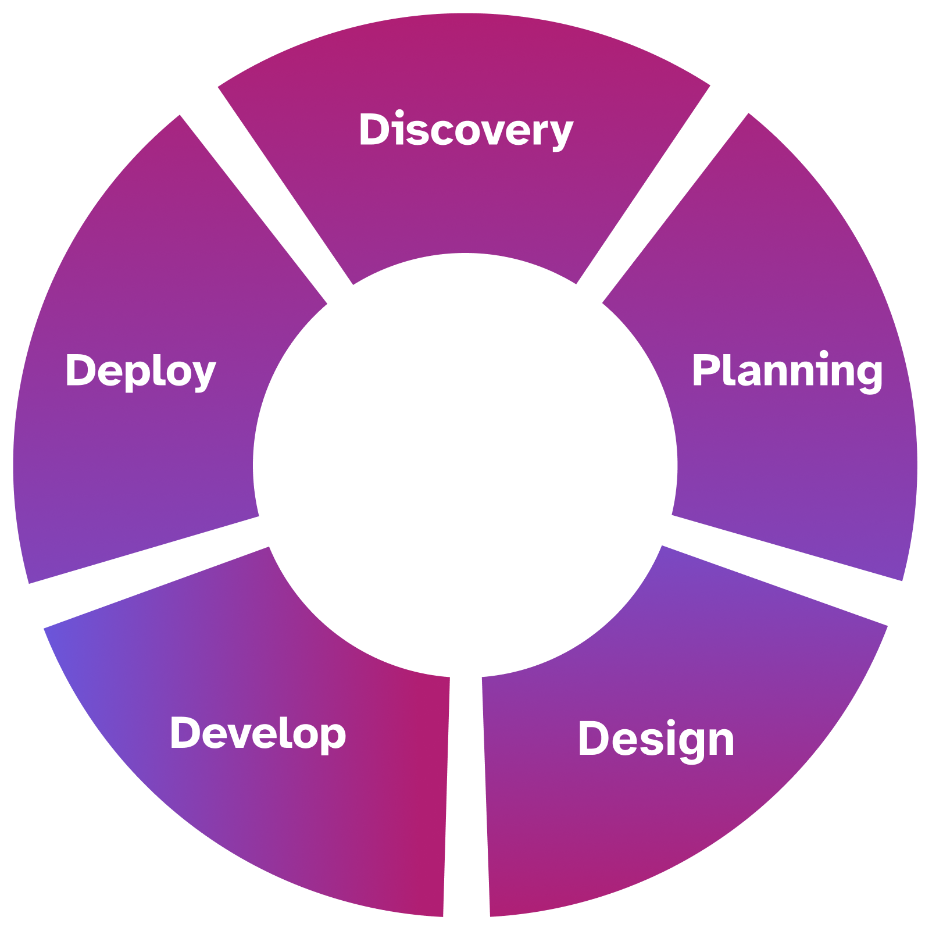
Design: development life cycle

Slide 6
Accessibility breakdowns
No continuous monitoring
Users with disabilities not considered
No accessibility testing
No accessibility project requirements
Designs not annotated

Slide 7
An accessibility playbook sets clear expectations and provides tools to achieve accessibility along product life cycles.

Slide 8
What is a playbook?
Guidance, governance, and policy
Roles & responsibilities
Living document
Components
  Stage gates
  Ceremonies
  Artifacts
  Tools

Slide 9

Stage gates
Gate 5: Continuous improvement
Gate 1: Planning readiness
Gate 4: Deployment readiness
Gate 2: Design readiness
Gate 3: Development readiness

Slide 10
Anatomy of a stage gate
When: The stage at which the check is required
Owner: Who should be involved​
A11y what: The requirements for accessibility success
Evidence: What comes out of your accessibility activities, artifacts​
Signal to proceed: What is the ready indicator
underneath this stage gate

Slide 11
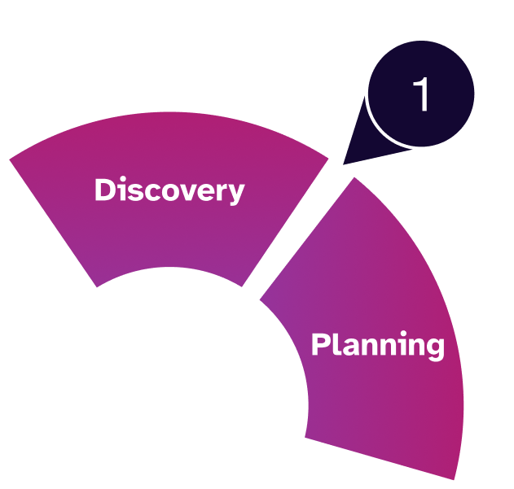
Stage 1: Planning readiness
When: Problem definition / early planning​
Owner: Product Lead (required), Design (optional)​
A11y what: Target users & use cases defined, a11y risks identified, constraints & assumptions documented
Evidence: Problem statement(s), early requirements & notes​
Signal to proceed: “We know which personas to include for accessible outcomes and the constraints”

Slide 12


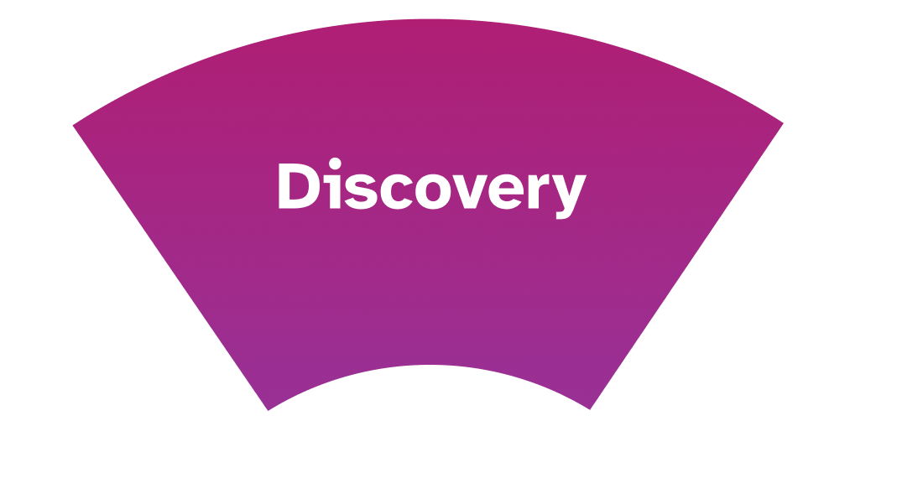
Stage 1 ceremonies
Design research sessions ​
When: Discovery, validation, usability testing ​
Owner: Researchers, Design, Product ​
A11y requirement: Research includes accessibility considerations and participants. ​
Example (research planning):
​“Are we capturing accessibility needs or assistive tech usage in this study?” ​
A11y what: User needs validated, a11y insights captured, assumptions corrected​
Evidence: Research plans, findings, synthesis notes
Other ceremonies include:
Design thinking workshops
Project / initiative kickoff
Feature kickoff

Slide 13
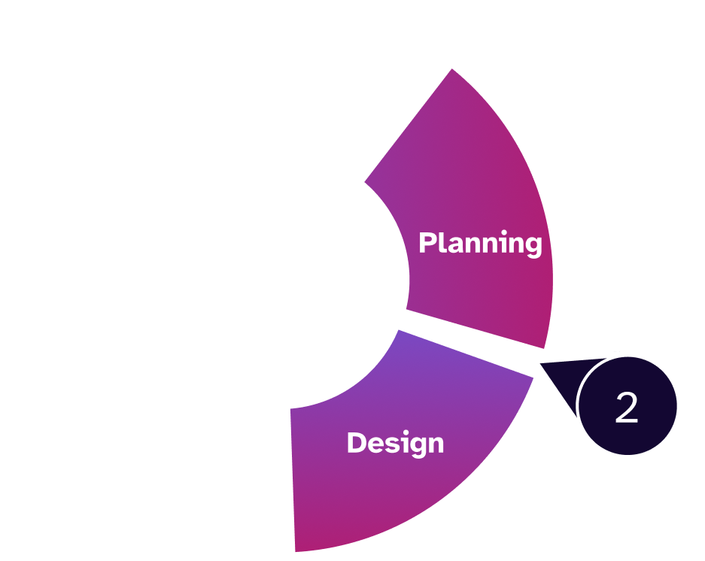
Stage 2: Design readiness
When: Before detailed design ​
Owner: Design ​
A11y what: Accessible patterns selected and / or ID’d,
content structure defined, interaction complexity understood,
project roles outlined ​
Evidence: Flows / low-fi designs, pattern references, design brief, personas ready / ID’d, testing strategy / knowledge gaps ID’d ​
Signal to proceed: “Accessibility interaction plans noted”

Slide 14
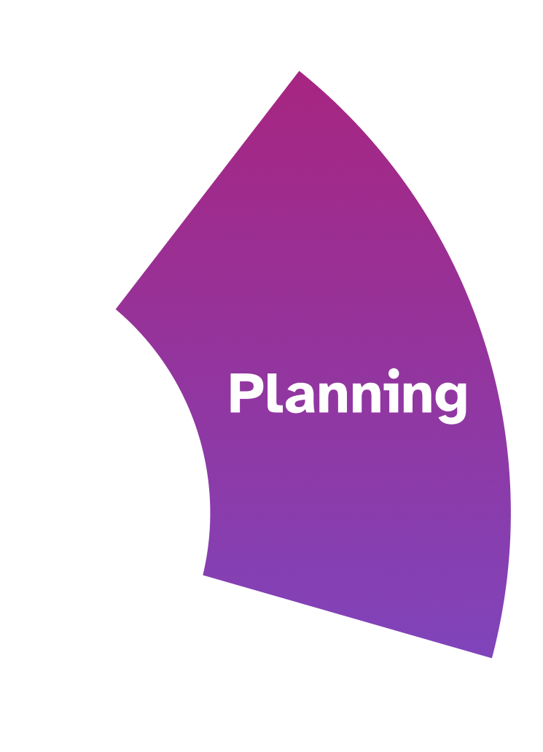

Stage 2 ceremonies
Design team workshops ​
When: Early design exploration / problem framing ​
Owner: Design leads, designers, facilitators ​
A11y requirement: Accessibility considered during ideation, not after
Example (workshop prompt): ​
“How would someone using only a keyboard complete this flow?”
A11y what: Inclusive assumptions challenged, risky concepts identified early.
Evidence: Workshop notes, whiteboards, early concepts or flows
Other ceremonies include:
Backlog grooming / refinement
Stakeholder review
Roadmap planning

Slide 15
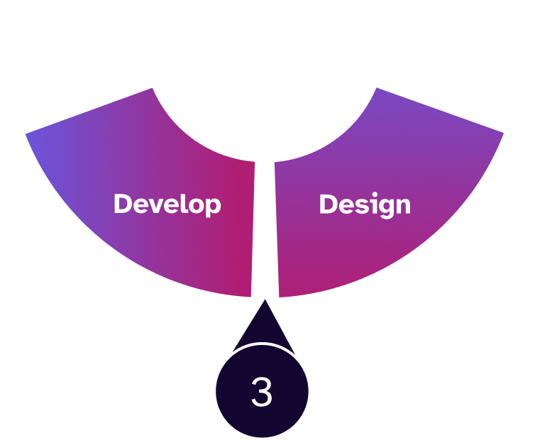
Stage 3: Development readiness
When: Backlog grooming / sprint planning ​
Owner: Engineering (required), Design (required), Product ​(optional)
A11y what: A11y acceptance criteria defined, component behavior explicit, known risks acknowledged, test plans ID’d, software tools installed ​
Evidence: Requirements added to stories / tasks, acceptance criteria, linked designs, all interactions for new components have understood references
Signal to proceed:
“This is ready to build,” or “Accessibility compliance scoped.”

Slide 16

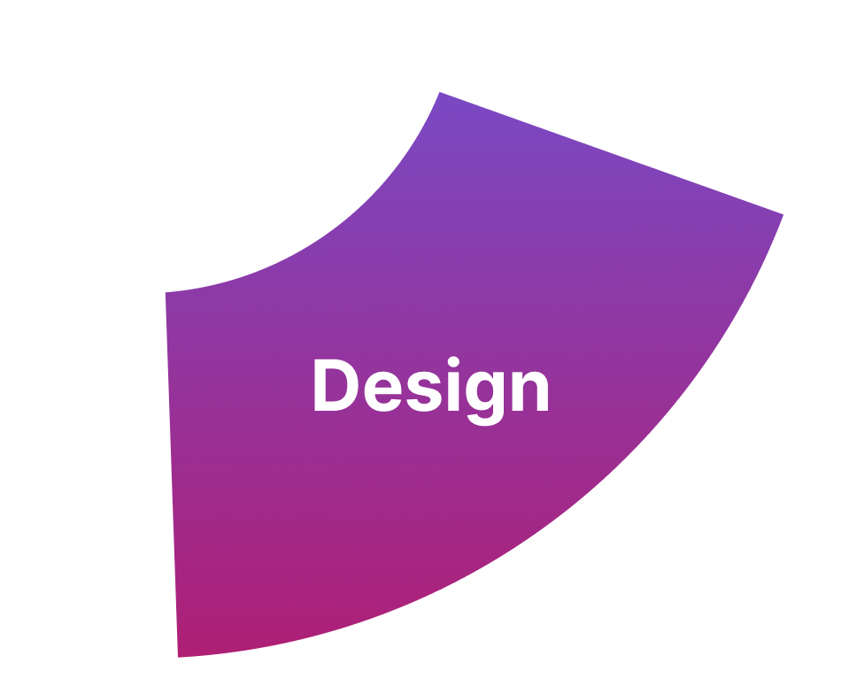
Stage 3 ceremonies
Design review / critique ​
When: Design milestones ​
Owner: Design leads, designers, accessibility partners, accessibility SME ​
A11y requirement: Design intent must be reviewable for accessibility before
hand-off. One or more people in the design review need to be the a11y champion.
Designs need annotations, documentation, and / or resources.
Examples (cross-functional review): ​“Can you walk me through the focus order and error handling for this flow?” “The white on black is compliant, but it’s very intense and may introduce reading fatigue, can we use a softer tone from the design system?”
A11y what: Contrast, focus, states, zoom, responsive behavior reviewed and validated​
Evidence: Annotated designs, review comments, updated design files
Other ceremonies include:
Design system / enablement review
Design hand-off

Slide 17
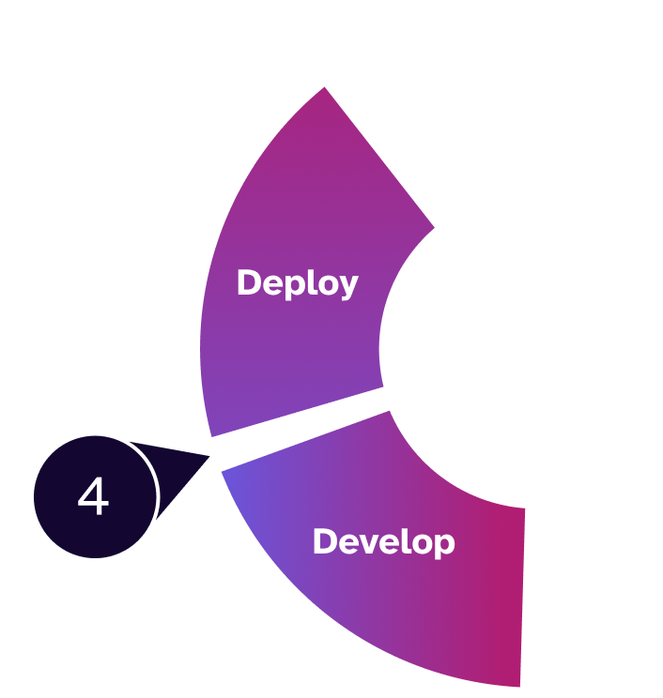
Stage 4: Deployment readiness
When: Feature complete / pre-release ​
Owner: QA (required), a11y champion(s) (required), Engineering ​(optional)
A11y what: Keyboard flow validated, SR basics checked, critical issues resolved or tracked, use case testing, third-party evaluation in dev / staging, support needs outlined​​
Evidence: Test notes, defects / tickets, a11y score
Signal to proceed: “We know what we’re shipping.”

Slide 18

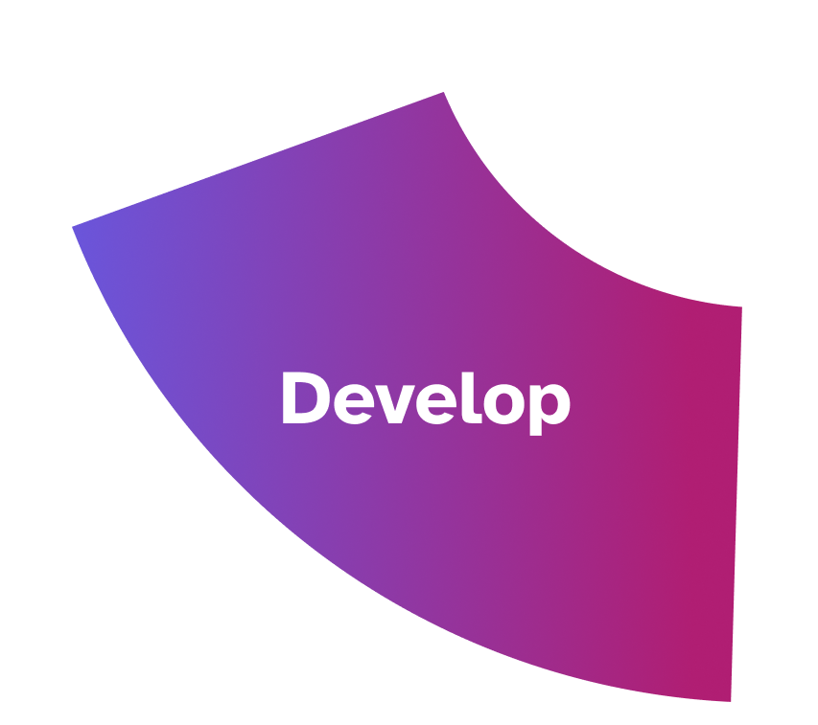
Stage 4 ceremonies
Accessibility testing ​
When: Feature complete / pre-release ​
Owner: QA leads, accessibility testers, engineers ​
A11y requirement: A11y validation must happen before release decisions.
Example (QA hand-off): ​”Have we validated keyboard flow and screen
reader output for the critical paths?”
A11y what: Keyboard, SR basics, contrast issues verified; defects
logged or triaged
Evidence: Test results, defect tickets, known-issue lists
Other ceremonies include:
Development sync / Engineering stand-up
Sprint review / demo
Regression testing

Slide 19
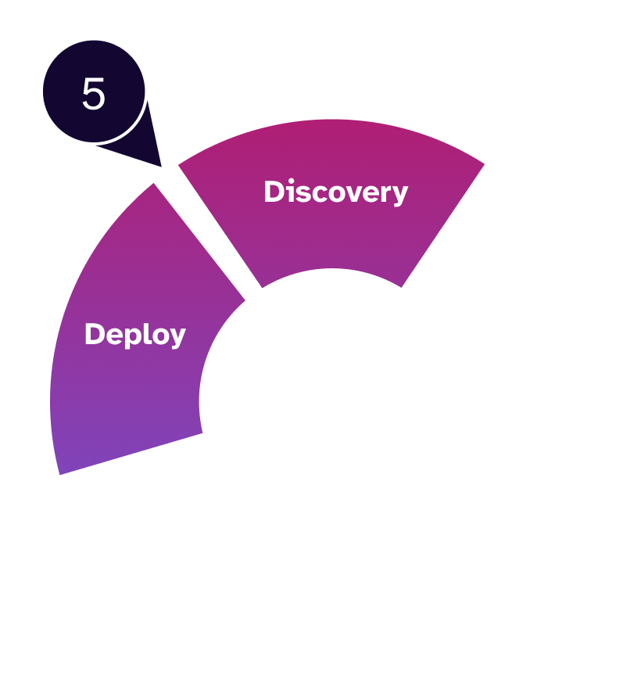
Stage 5: Continuous improvement
When: Post-release / retro​
Owner: Full SDLC team, Scrum Master, leadership ​
A11y what: Friction identified, upstream fixes defined, system gaps addressed, processes analyzed, ceremonies start / stop / continue
Evidence: Retro notes, process or system updates, a11y score change​
Signal to proceed: “The system improves, not just the feature.”

Slide 20
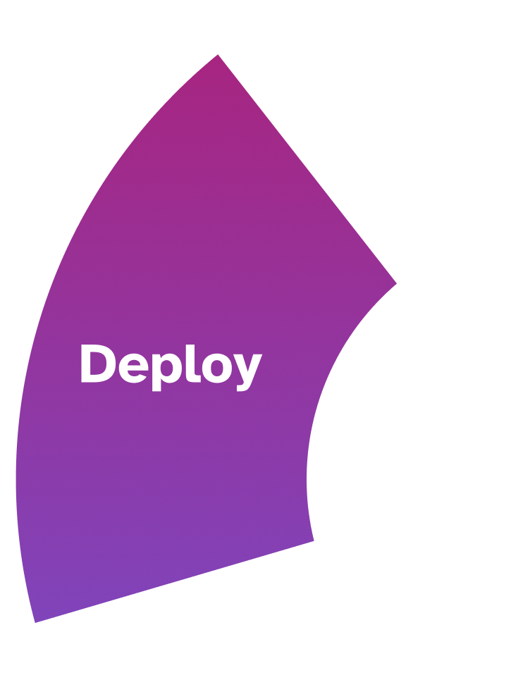
Stage 5 ceremonies
Retrospective
When: End of sprint / release ​
Owner: Team ​
A11y requirement: A11y friction feeds system improvement, not blame. ​
Example (retro):
​”What accessibility issue could we have caught earlier?”
A11y what: Process gaps identified, upstream improvements proposed
Evidence: Retro notes, action items, updated processes or stage gates
Other ceremonies include:
Monitoring scans
User feedback / VOC review
Post-release review

Slide 21






Tools for your playbook
Discovery / planning
Ask Level AI: Get context-specific answers to questions without leaving your workflow.
Planning / design
Project management integrations: Seamlessly sync data from the platform to your existing issue tracking software.
Design / develop
Figma Plugin: Easily scan links, buttons, checkboxes, and more to identify accessibility barriers, and quickly apply fixes directly to your design.
Develop / deploy
Evaluations: Identify accessibility barriers and gain actionable guidance for fixing them through manual testing by experts, including people with disabilities.
Develop / deploy
Level CI: Drive efficiency by proactively embedding accessibility in your CI/CD pipeline. ​
Deploy / discovery
Scanning & Monitoring: Build remediation into live websites to improve site accessibility without adding to workloads. ​

Slide 22
Conclusion

Slide 23
Ready to start your own playbook?
QR Code to be placed when ready

Slide 24
Q & A

Slide 25
Thank you

